Slide 1
ADVENTURE WORKS project by: KOUSHIK SELVABHARATHI S MADHU R BANGERA MEESALA RENUKA ABDUL RAASHID S G SAI ASHISH

Slide 2
Agenda
Introduction
Data Overview
Objectives
Process
Analysis
Recommendations and Insights
Conclusion
Challenges & Learnings
Dashboard

Slide 3

Adventure Works: Introduction
Domain Overview
Problem Statement
Adventure Works operates in the manufacturing and retail domain, focusing on bicycles and bicycle-related components. The business handles end‑to‑end activities including production, sales, and distribution across multiple regions.
Although Adventure Works has achieved consistent sales, the business lacks a centralized analytical view to track performance across time, products, customers, and regions. Decision‑making was heavily dependent on raw data without clear insights.
Company Overview
Adventure Works Cycles is a multinational manufacturing company with operations across North America, Europe, and Asia. The company manufactures metal and composite bicycles and distributes them through regional sales teams. Its core operations are based in Bothell, Washington, with additional manufacturing support from Mexico.
Goal of the Project
The main goal is to analyze sales and profit performance and convert raw data into actionable insights that help stakeholders understand trends, identify high‑performing segments, and improve business strategies.

Slide 4


Data Overview
Source & Format
Data provided in Excel format, comprising multiple fact and dimension tables crucial for comprehensive analysis.
Key Data Files
Fact Tables: Fact Internet Sales, Fact Internet Sales_ New
Dimension Tables: Dim Product, Dim Customer, Dim Date, Dim Sales Territory
Timeline & Volume
Covers sales and profit data from 2010 to 2014, including Sixty thousands of transactional records
Core Metrics
Key columns include Order Date, Sales Amount, Production Cost, Profit, and Category, Sub Category Customer, and region data.

Slide 5

Objectives: What We Aimed to Discover
Our analysis was designed based on client requirements, with a focus on understanding business performance, identifying growth opportunities, and supporting data-driven decision-making.
The main goal of this project is to convert raw data into meaningful insights that help stakeholders clearly understand sales, profit, and customer behavior..
Year-wise Sales Trends
Top 5 Customers by Profit
Understanding annual performance fluctuations and identifying peak periods.
Pinpointing key customer segments for targeted engagement and loyalty programs.
Top 5 Products by Sales
Highlighting best-selling products to inform inventory and marketing strategies

Slide 6
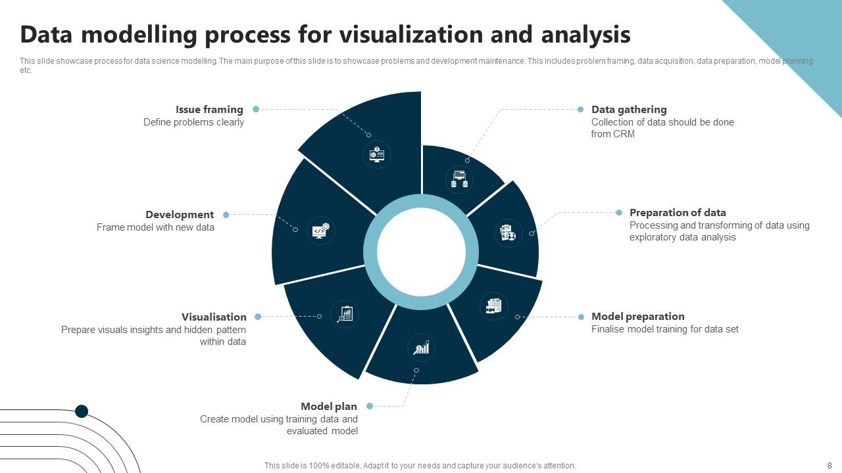
Process: Data Preparation to Modeling
This project follows a structured and systematic approach to ensure data accuracy, consistency, and reliability. Each step is carefully designed to transform raw data into meaningful insights for effective decision-making.
Our robust process ensures data integrity and meaningful insights.
Data Cleaning
Removed duplicates, invalid records, and handled missing values; standardized column names.
Data Collection
All Excel files imported into Power BI; initial consistency verification
Data Transformation
Appended fact tables, merged product dimension tables for a unified view.
Data Modeling
Built a star schema model with established relationships for comprehensive analysis
Feature Engineering
Extracted date components (Year, Quarter, Month) and created key measures (Sales, Cost, Profit, Margin).

Slide 7
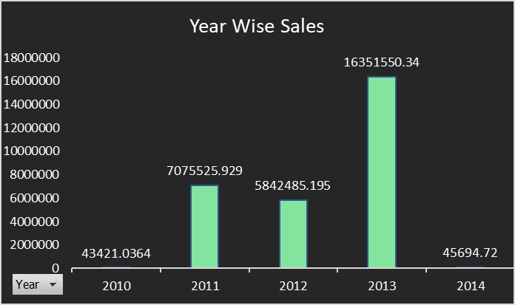
Analysis: Key Business Performance Evaluation
This analysis examines sales trends, top customers, best-performing products, and regional sales distribution. The goal is to uncover actionable insights that help improve business performance and profitability..
Insight
Sales showed steady growth from 2010 to 2013
2013 was the highest performing year
Slight dip observed in 2014 due to limited data availability

Slide 8
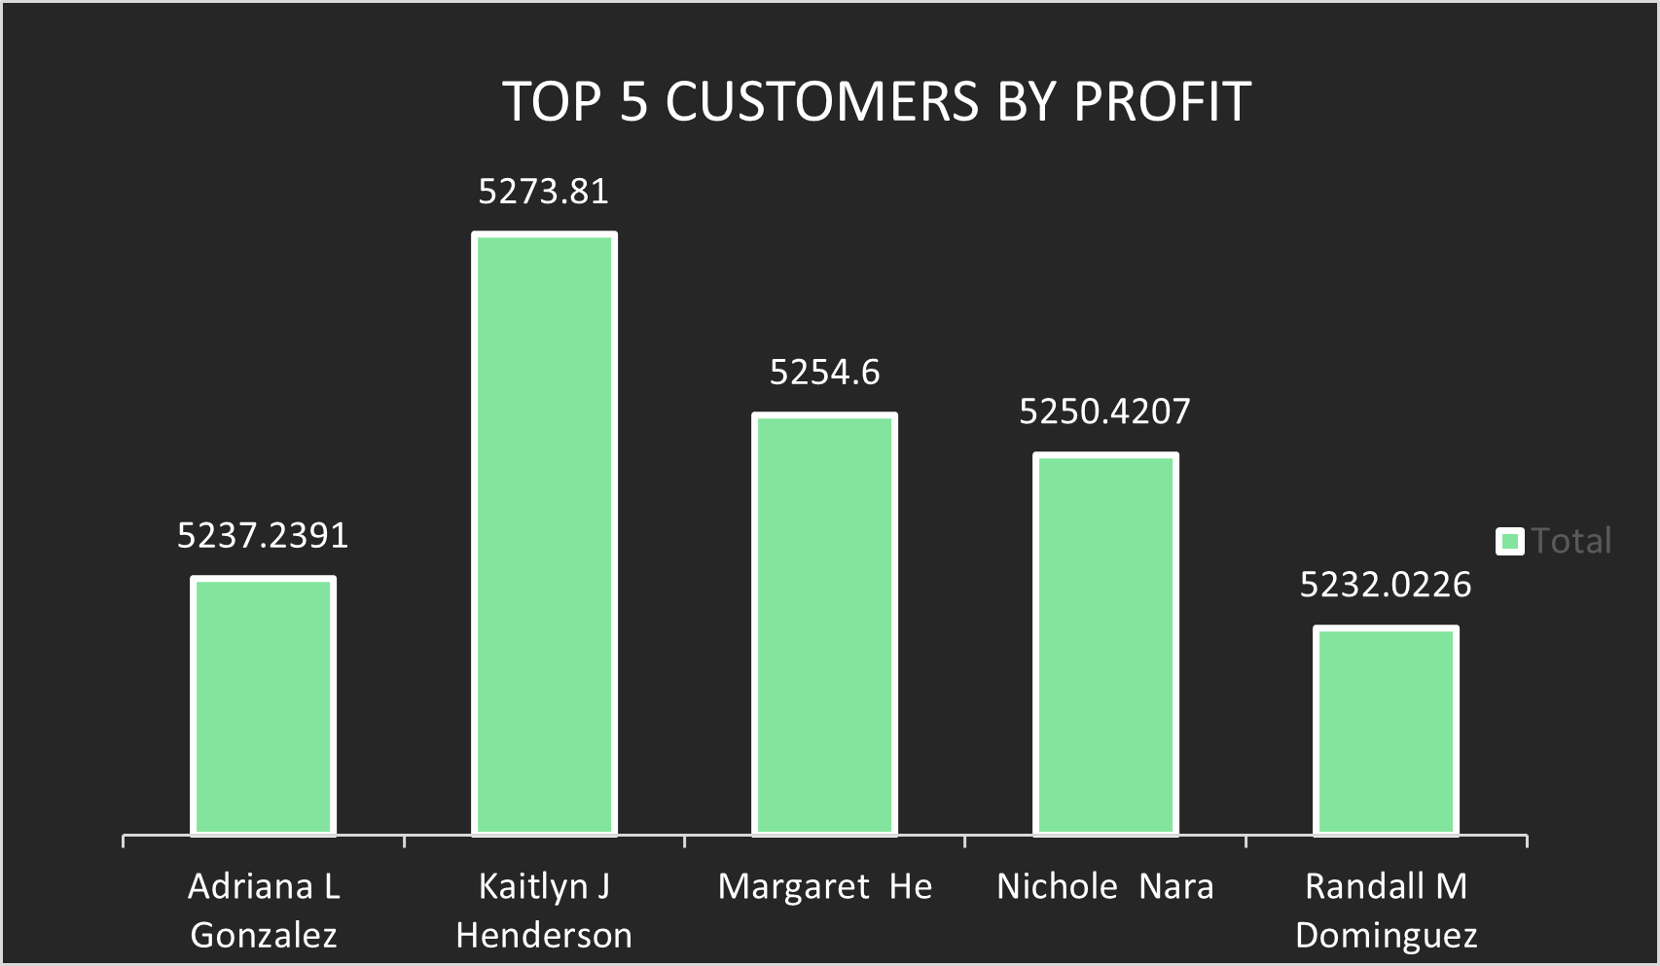
Top 5 customers By Profit
Insight
KAITLYN J HENDERSON is the highest profit-contributing customer, clearly leading the group.
A small set of customers contributes a disproportionately high share of profit, with one clear top contributor.
This indicates customer concentration risk and an opportunity to design retention and loyalty strategies for high-value customers.

Slide 9
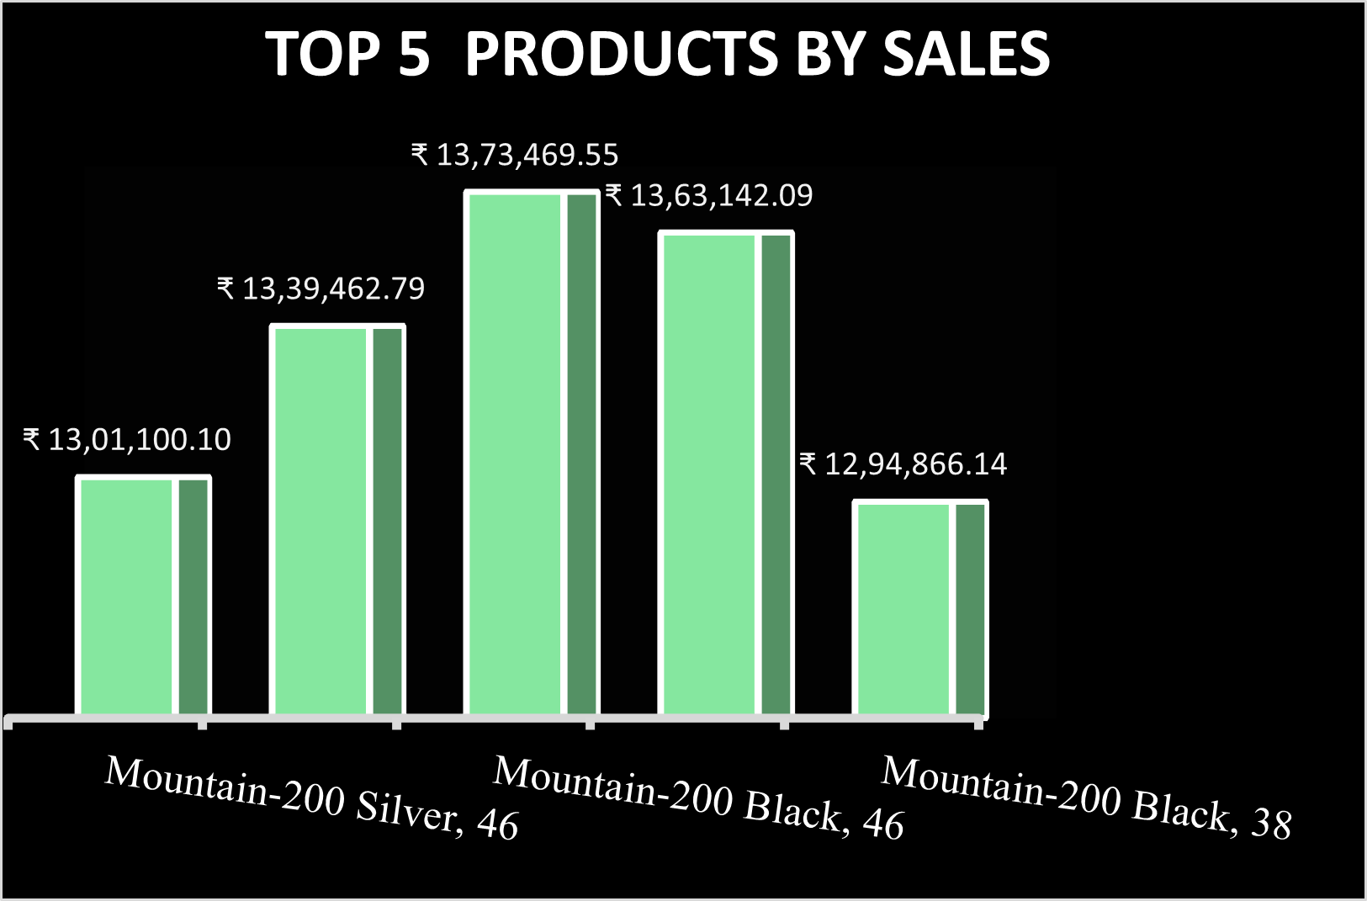
Top 5 Products by Sales
Insight
Mountain-200 Black variants consistently generate the highest sales among top products.
Sales across the top 5 products are fairly balanced, showing diversified product demand.
Consistent performance across variants suggests demand is product-led rather than promotion-led..
Focusing inventory, pricing, and marketing on these top SKUs can maximize revenue efficiency

Slide 10




Recommendations & Insights
Target High-Profit Customers
Optimize Product Inventory
A small group of customers contributes a major share of profit. Prioritizing retention and personalized engagement for these customers can maximize returns.
Increase stock levels for top-selling products to meet demand and prevent stockouts
Enhance Cost Efficiency
Expand Digital Sales
Some regions and products show low or zero profitability. Reviewing costs in these areas can help improve margins or guide strategic adjustments.
Invest in and grow online sales channels to reach a broader audience and improve accessibility.

Slide 11
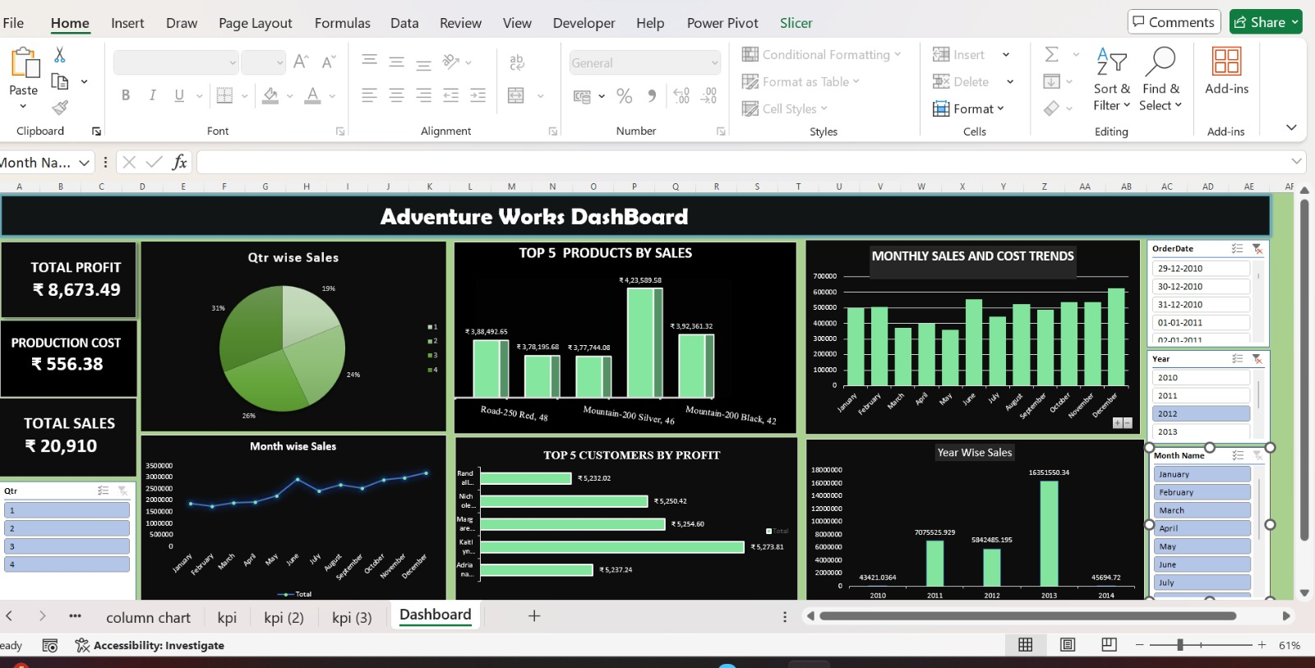
EXCEL DASHBOARD

Slide 12
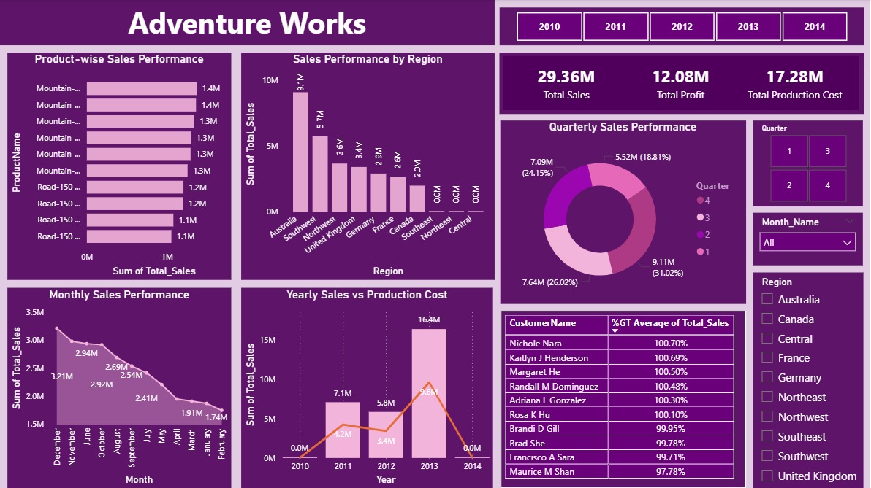
POWER BI DASHBOARD

Slide 13
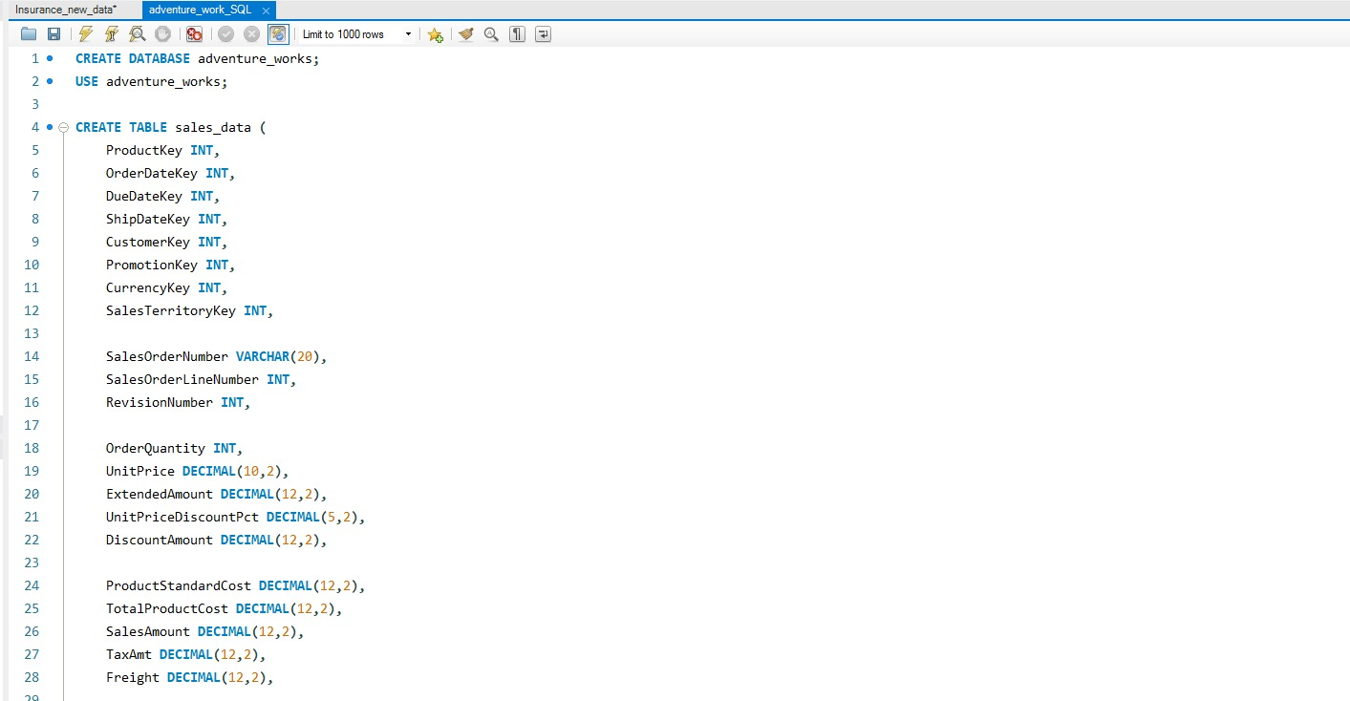
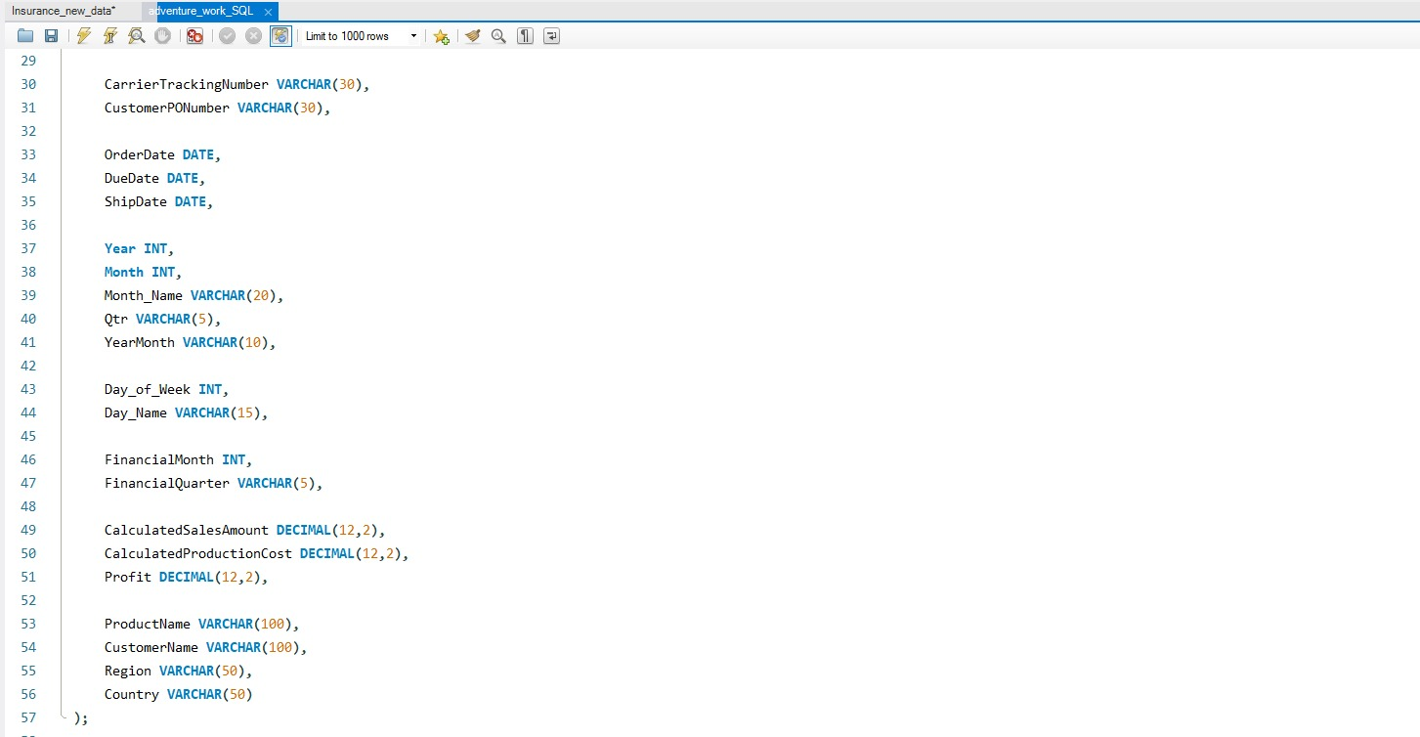
MYSQL SCRIPT FILE

Slide 14
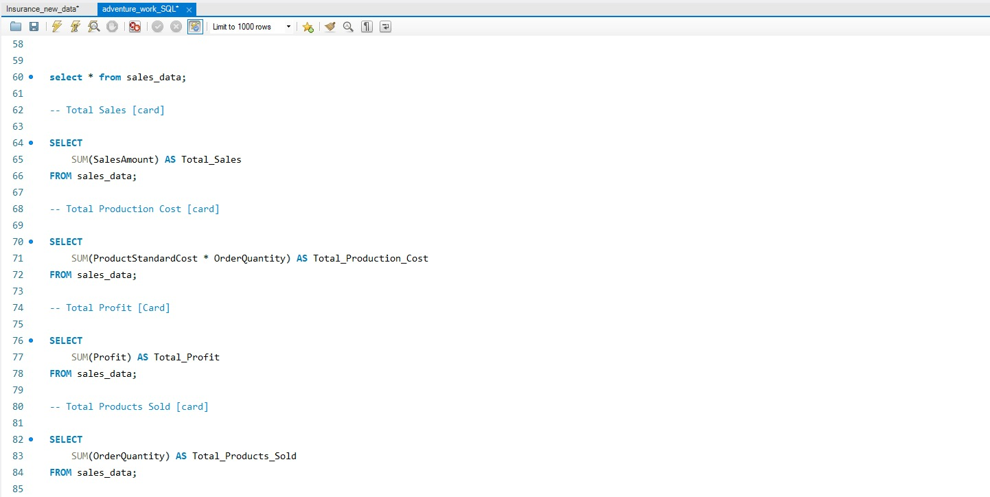
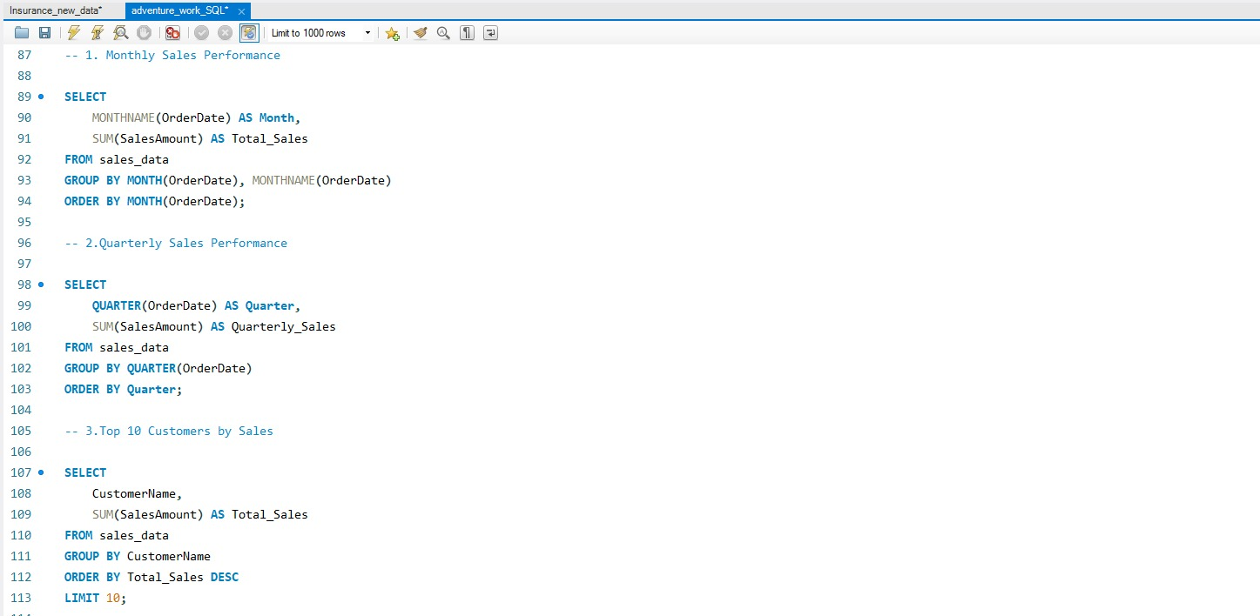

Slide 15
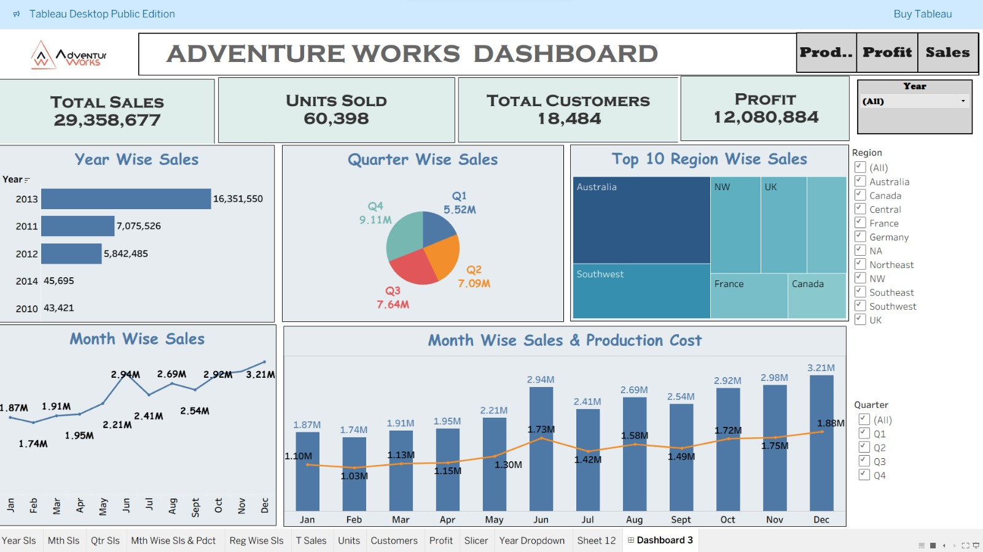
TABLEAU DASHBOARD

Slide 16
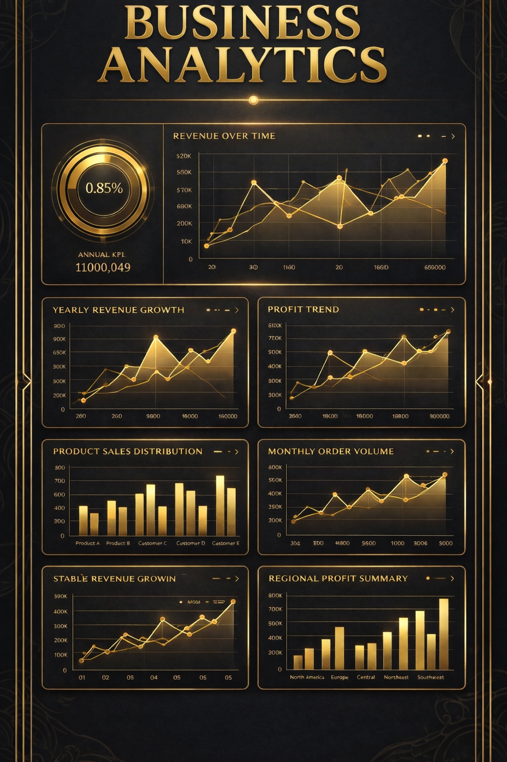
Key Takeaways & Future Outlook
Challenges Overcome
Learnings & Impact
Designing dynamic dashboards with slicers, filters, and bookmarks.
Mastery of data modeling techniques and DAX calculations.
Proficiency in dashboard design for business users
Resolving inconsistent date formats and granularity issues.
Understanding how data insights support business decision-making..
Developing accurate DAX measures for reliable insights.
Improved ability to analyze data and present insights in a clear, meaningful way.
Handling data cleaning and preparation across multiple data sources.

Slide 17
Conclusion
Overall, the business performance shows that sales and profit are mainly driven by a small number of key products, customers, and regions. The Mountain-200 product series contributes significantly to total sales, indicating strong and consistent demand. Profit is highly concentrated in regions such as the United States and Australia, while a few customers account for a large share of overall profit. At the same time, some regions and segments generate very low or no profit, highlighting areas that need cost control or performance improvement. In summary, the business is doing well, and future growth can be achieved by strengthening high-performing areas and improving weaker ones.

Slide 18
Thank You!
We appreciate your time and attention today. We're confident that these data-driven insights will empower Adventure Works to make more informed decisions, optimize operations, and continue its journey of growth and innovation.

